Slide 1
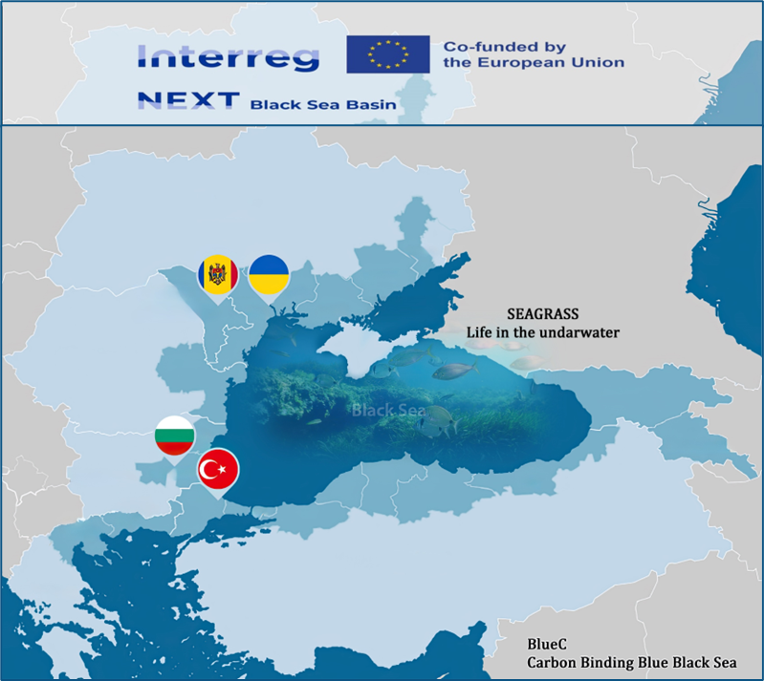
BlueC Project – Activity Report

Slide 2
INTRODUCTION
This report summarizes the activities carried out under the BlueC Project by the Expert Educator. The project, funded by the Interreg NEXT Black Sea Basin Programme 2021–2027, aims to strengthen ecosystem-based education and awareness about blue carbon and aquatic vegetation. The role of the Expert included curriculum development, survey design, and training coordination.

Slide 3
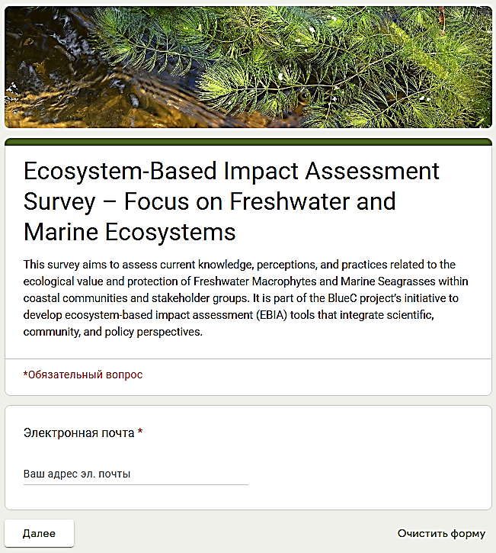

Ecosystem-Based Impact Assessment Survey – Focus on Freshwater and Marine Ecosystems
The draft questionnaire was developed and adapted to the situation in the Republic of Moldova, namely for freshwater macrophytes - Ceratophyllum demersum L.
https://docs.google.com/forms/d/1xmy9IZGj2RDLOWaCXoUc5kLEIS87qi2fXptfXezOThE/edit

Slide 4
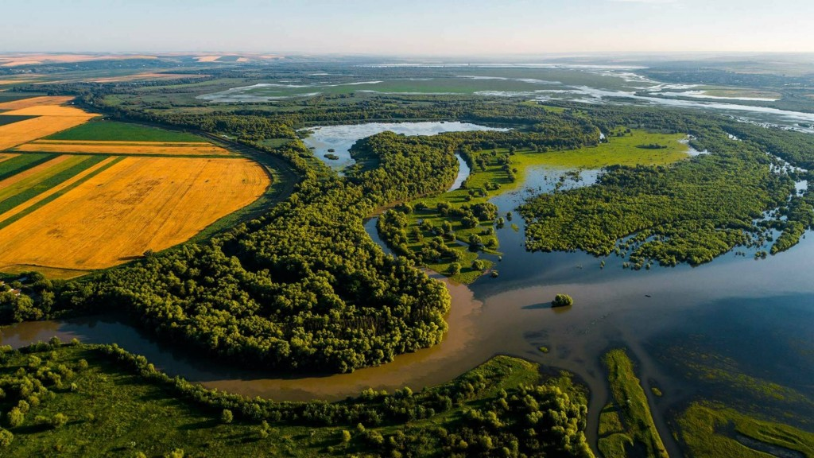
Ceratophyllum demersum L.

Slide 5
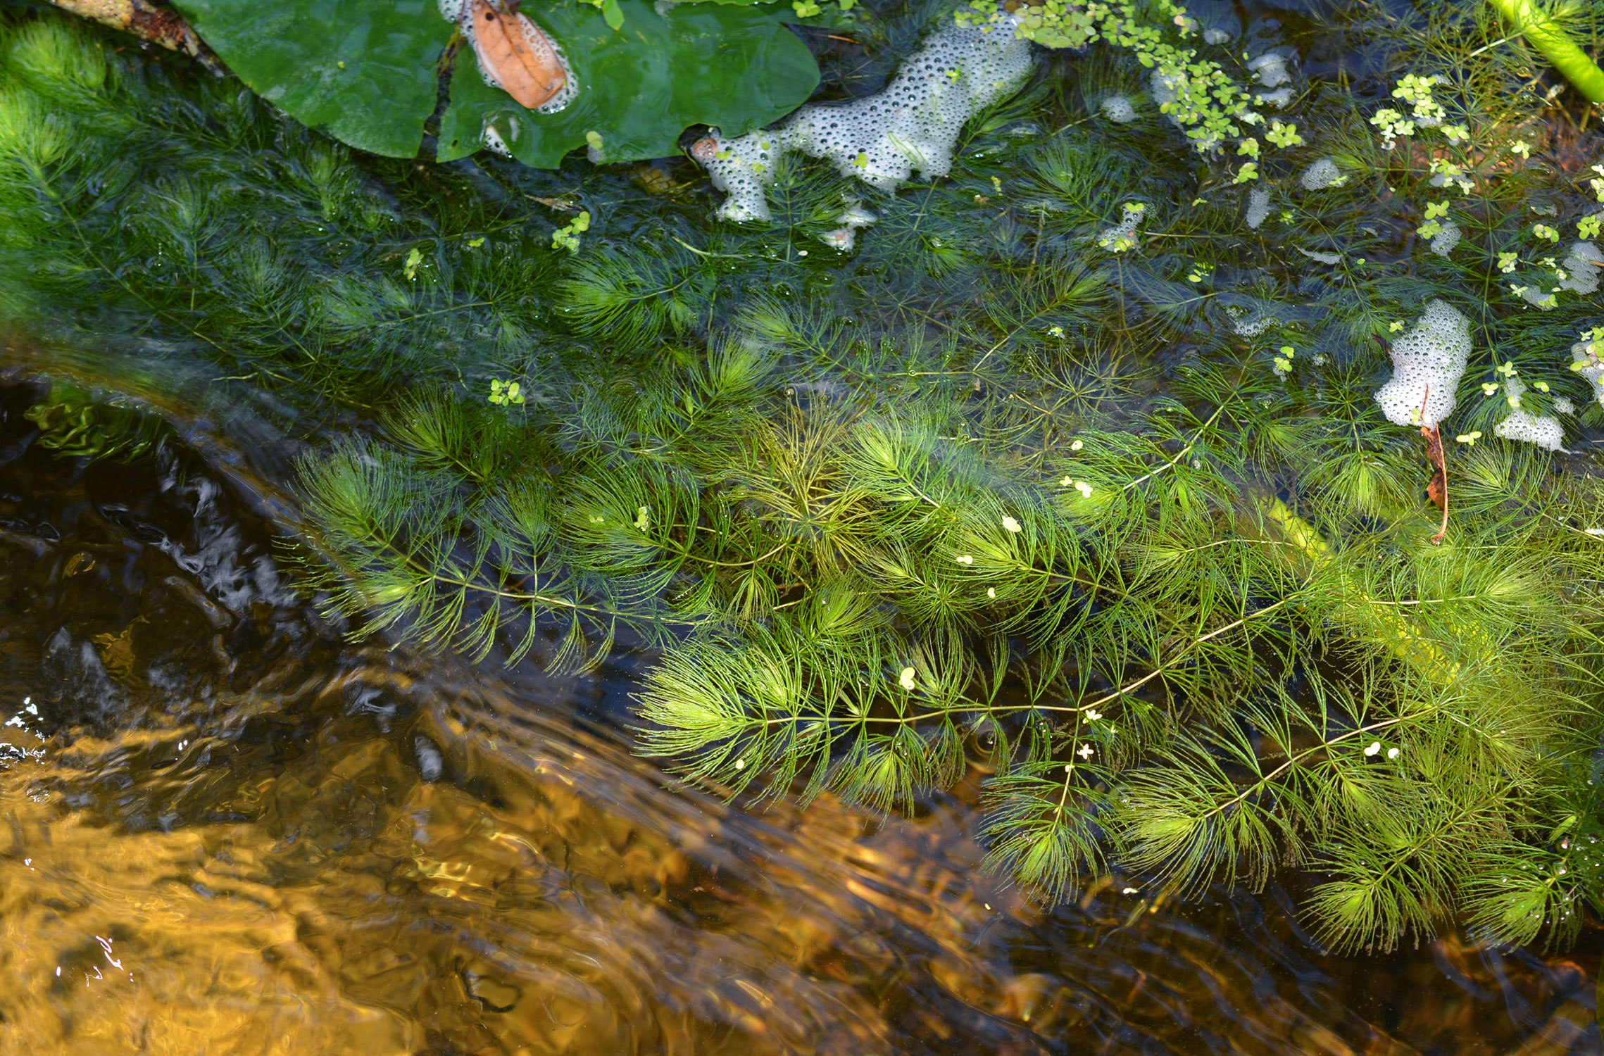
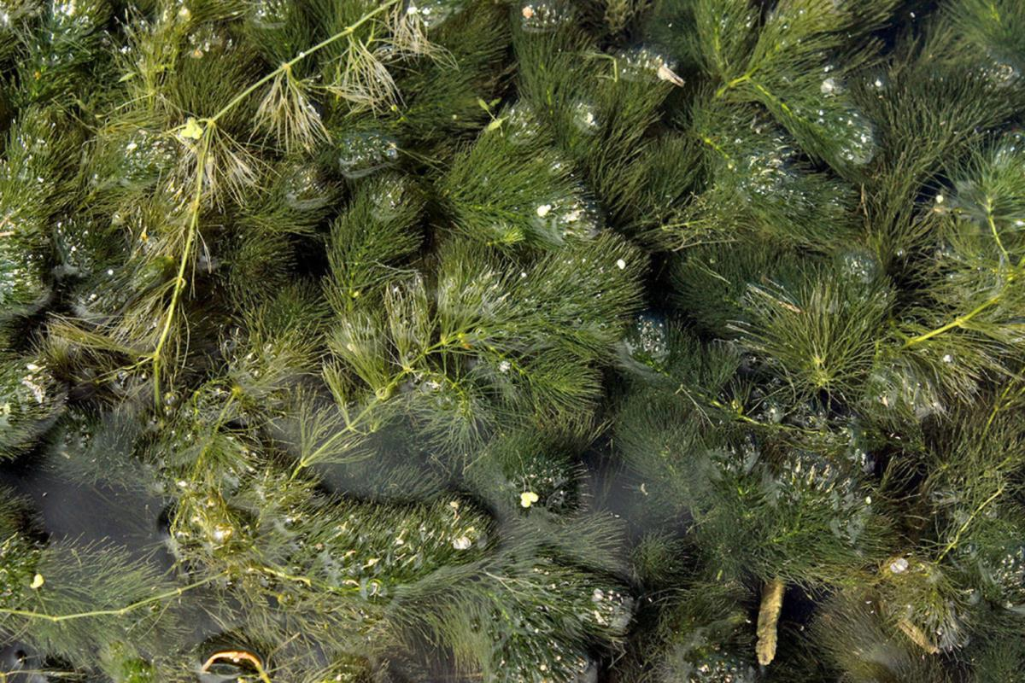
Ceratophyllum demersum L.
Ceratophyllum demersum, commonly known as hornwort, is a submerged aquatic plant prevalent in Lacul Beleu, situated within the Lower Prut Scientific Reserve in southern Moldova. This species plays a pivotal role in maintaining the ecological balance of the lake's freshwater ecosystem. While not a seagrass, Ceratophyllum shares several ecological functions with marine seagrasses, highlighting the interconnectedness of aquatic plant communities across different environments.
Connectivity with Seagrass Ecosystems
Although Ceratophyllum demersum is a freshwater species and seagrasses are marine, they exhibit functional similarities that underline the connectivity between freshwater and marine ecosystems:
Ecosystem Services: Both plant types play crucial roles in sediment stabilization, nutrient cycling, and providing habitats for aquatic organisms.
Carbon Sequestration: Like seagrasses, Ceratophyllum contributes to carbon sequestration by absorbing CO₂ during photosynthesis and depositing organic matter into sediments.
Indicator Species: The health of Ceratophyllum populations can reflect the ecological status of freshwater systems, just as seagrasses are indicators of marine environmental quality.
Hydrological Connectivity: Rivers and estuaries serve as transitional zones where freshwater and marine plants can influence each other. Nutrient and organism exchanges in these areas highlight the importance of maintaining connectivity between different aquatic habitats.

Slide 6
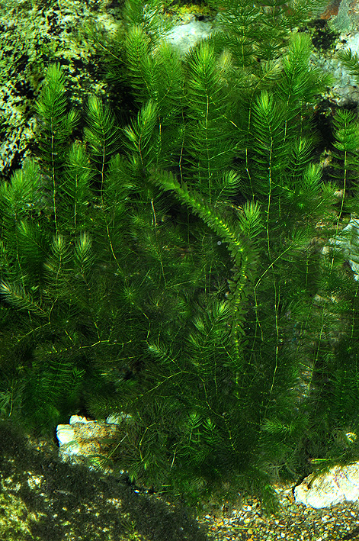
Differences Between Freshwater Macrophytes and Marine Seagrasses
FEATURE | FRESHWATER MACROPHYTES | MARINE SEAGRASSES
Evolutionary Origin | More diverse; minimal structural change from land ancestors | Evolved specialized forms adapted to saline, submerged life
Reproductive Strategy | Pollination often via water surface or air | Hydrophilous pollination (pollen in water)
Rooting and Rhizomes | Often loosely anchored; rhizomes not always dominant | Extensive rhizome networks stabilize sediment
Physiological Adaptations | Lower bicarbonate use; CO₂ more readily available | High affinity for bicarbonate due to seawater chemistry (Sand-Jensen & Gordon, 1984)
Grazing Pressure | Mainly by waterfowl, less by fish | High herbivory from sea turtles, urchins, fish
Carbon Sequestration | Less biomass storage | High sequestration via deep sediment burial (Stevenson, 1988)

Slide 7
BlueC Education Syllabus (Draft)
Together with the Education Consultancy Committee, have developed of the draft curriculum targeting various stakeholder groups, including high school pupils, students, teachers, NGOs, and local community members. The curriculum includes core topics such as:
Aquatic ecosystems and biodiversity
Role of Ceratophyllum demersum and seagrasses
Circular economy and nature-based solutions
Climate mitigation and blue carbon
Ecosystem-Based Impact Assessment (EBIA)
Learning Objectives
By the end of the course, learners will be able to:
Understand key aquatic ecosystems in the Black Sea Basin and their biodiversity;
Describe the ecological functions of Ceratophyllum demersum in Lacul Beleu;
Identify the roles of seagrasses in carbon capture and coastal protection;
Understand threats to aquatic ecosystems and how ecosystem-based assessments work;
Engage in basic ecosystem monitoring and community-based conservation.

Slide 8
TOPIC 1. Introduction to Aquatic Ecosystems & the BlueC Project
Overview of Black Sea biodiversity and climate impacts.
Introduction to Blue Carbon and the goals of the BlueC project.
Key terms: macrophytes, Ramsar wetlands, ecosystem services.
TOPIC 2. Lacul Beleu & Ceratophyllum demersum
Field ecology of Ceratophyllum demersum: morphology, lifecycle, functions.
Carbon sequestration and biodiversity support.
Seasonal dynamics and human impacts.
TOPIC 3. Seagrass Meadows and Marine Ecosystems
Types of seagrasses and their distribution in the Black Sea.
Role in coastal protection, nursery habitats, and carbon storage.
Differences from freshwater macrophytes.
TOPIC 4. Marine Seagrasses & Cross-System Connectivity
Marine vs. freshwater macrophytes
Ecosystem connectivity: estuaries, lakes, and seas
Role of seagrasses in coastal protection and fishery support
TOPIC 5. Threats and Pressures on Aquatic Habitats
Eutrophication, sedimentation, and pollution.
Climate-driven stress and invasive species.
Community mapping of threats (use of GIS / Marine Litter app).
TOPIC 6. Ecosystem-Based Impact Assessment (EBIA)
What is EBIA? How does it differ from traditional EIAs?
Stakeholder engagement and survey tools.
Drafting local impact questionnaires.
TOPIC 7. Nature-Based Solutions and Phytoremediation
Aquatic plants for water purification and bioindicator roles.
Ceratophyllum and seagrasses in phytoremediation.
Design of simple wetland experiments.
TOPIC 8. Threats & Ecosystem Pressures
Pollution, invasive species, climate shifts
Marine litter and nutrient runoff impacts
Tools for community-based monitoring (Marine Litter Watch, biodiversity apps)

Slide 9
TOPIC 9. Circular Economy & Ecosystem Services
Core Concepts: waste reduction, reuse, value chain thinking
Aquatic Bioresources in Circular Economy: How biomass like Ceratophyllum can be:
  Processed into compost or biofertilizer
  Used for fish feed or biogas
  Integrated into local value chains (e.g., eco-packaging, bioplastics)
TOPIC 10. Economic Value & Impact of Ceratophyllum
Quantifying Ecosystem Services:
  Water filtration = savings on purification costs
  Habitat provisioning = fishery productivity
  Carbon sequestration = potential carbon credit valuation
Risks & Costs:
  Biomass removal in eutrophic years
  Maintenance burden on irrigation/agriculture
Value-Added Products: Feed additive (e.g., in carp farming), raw material in wetland restoration projects
TOPIC 11. Policy and Conservation Practices
How ecosystem-based management informs policy.
International conventions: Ramsar, EU Blue Growth, Black Sea Synergy.
Role of students and communities in conservation
🌿 OPTIONAL EXTENSION TOPICS
TOPIC 1. From Biomass to Business
Business models from aquatic biomass
Youth-led eco-entrepreneurship opportunities
Examples: Biogas from macrophytes, organic fish feed, natural dye extraction
TOPIC 2. Policy & Career Futures
Career paths in environmental science, bioeconomy, and policy
Ecosystem-based governance and SDG connections
Youth engagement in EU Green Deal and regional blue strategies

Slide 10
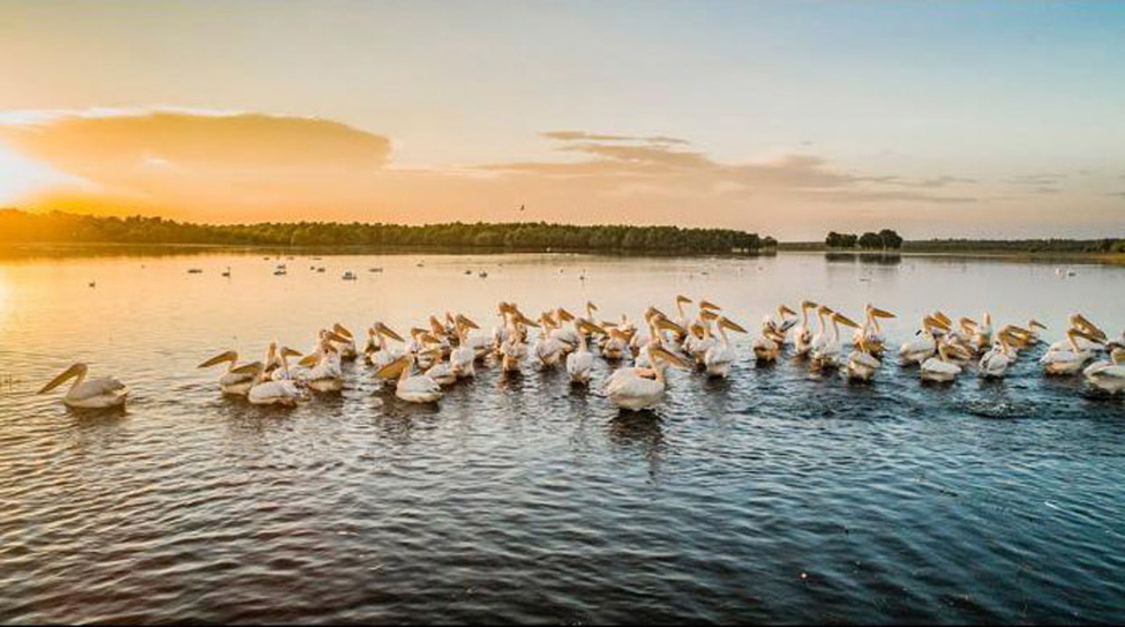
Thank you for your attention!

