Slide 1



Conservation of the Black Sea Marine Biodiversity: A Microbiological Perspective and GIS-Based Approaches
Assoc. Prof. Dr. Ali KOCYIGIT
Ege University Faculty of Science
Biology Department, Basic and Industrial Microbiology Section, İzmir, Türkiye

Slide 2
Contents
1. Introduction to the Black Sea Ecosystem
2. Microbial Diversity in the Black Sea
3. Anthropogenic Pressures & Threats
4. Microbiological Monitoring and Indicators
5. GIS-Based Approaches
6. Recommendations and Future Directions

Slide 3
1. Introduction to the Black Sea Ecosystem
The Black Sea is
a semi-enclosed,
inland sea bordered by six countries
(Bulgaria, Romania, Ukraine, Russia, Georgia, and Turkey) and
connected to the Mediterranean via the Bosphorus Strait.
Its unique hydrography,
including a strong halocline and a permanent anoxic deep layer below ~150–200 meters,
creates a distinctive microbial environment and challenges for biodiversity conservation.

Slide 4
Salinity and Depth Characteristics of the Black Sea
1. Surface Layer (0–50 m)
Salinity: 17–18 PSU (practical salinity units)
Reason: Massive freshwater input from rivers (especially in the northwest), combined with limited mixing and restricted outflow through the Bosphorus.
Result: The surface is significantly less salty than global ocean average (~35 PSU).

Slide 5
2. Pycnocline (50–150 m)
A strong halocline exists here, where salinity increases rapidly with depth.
This layer acts as a barrier to vertical mixing of surface and deeper waters.
3. Deep Water Layer (>150 m to ~2200 m)
Salinity: Stabilizes at around 22 PSU
Conditions: This layer is permanently stratified and anoxic (oxygen-free), making it one of the largest anoxic basins in the world.
Stability: Salinity and temperature are remarkably stable here over time.
Water Exchange Mechanism
Two-layer flow in the Bosphorus:
Surface inflow from the less salty Black Sea to the Aegean
Deeper inflow of saltier Mediterranean water (~38 PSU) into the Black Sea
Mediterranean inflow sinks below the less dense freshwater, enriching the deep layer's salinity but never reaching the surface.

Slide 6

1. Introduction to the Black Sea Ecosystem
• Geographic and oceanographic features
• Unique hydrography
(anoxic deep layers, river inflows)
• Importance of biodiversity for regional and global ecology
Notes:
Emphasize the Black Sea's semi-enclosed nature, limited water exchange, and unique stratification. Discuss how these physical properties affect microbial biodiversity and ecosystem functioning.

Slide 7
1. Introduction to the Black Sea Ecosystem
Microbiological Uniqueness
Anaerobic microbial communities thrive in the deep, euxinic (sulfide-rich) layers, where oxygen is absent.
Surface and coastal waters host diverse
bacterioplankton,
cyanobacteria, and
algae, many of which respond rapidly to pollution or eutrophication.
Microbial diversity is a key indicator of ecosystem stress and functionality — influencing nutrient cycling, detoxification, and primary production.

Slide 8
2. Microbial Diversity in the Black Sea
• Key microbial groups
(bacteria, archaea, cyanobacteria, microalgae)
• Functional roles:
nutrient cycling,
primary production,
detoxification
• Anaerobic microbial communities in deep layers
Notes:
Highlight key microbial groups: bacteria, archaea, cyanobacteria, and microalgae. Explain how microbial life supports nutrient cycling, detoxification, and primary production.

Slide 9

3. Anthropogenic Pressures & Threats
• Eutrophication from river runoff
(Danube, Dniester, Dnieper and others)
• Hypoxia & dead zones
• Harmful algal blooms (HABs)
• Microplastic pollution and its microbial interactions
• Invasive microbial species
Notes:
Eutrophication from major rivers causes hypoxic zones. Algal blooms are exacerbated by nutrient load. Discuss the role of microplastics and invasive microbes.

Slide 10
Tracing Harmful Algal Blooms (HABs)
Methods:
Satellite Remote Sensing:
Detects chlorophyll-a, sea surface temperature (SST), and ocean color.
Tools: MODIS, Sentinel-3 OLCI, NOAA HAB-OFS (Forecasting System).
In-situ Sampling:
Periodic water sampling for algal cell counts.
Identification by microscopy or flow cytometry.
Molecular Methods:
qPCR or RT-PCR targeting toxin-producing algal genes.
eDNA sampling to detect species even in low abundance.
Toxin Assays:
ELISA or LC-MS/MS to quantify algal toxins in water or shellfish.
Key Indicators:
Rapid increase in chlorophyll-a.
Dominance of specific harmful taxa (e.g., Alexandrium, Pseudo-nitzschia, Microcystis).
Presence of toxins like domoic acid, saxitoxin.
GIS Application:
Overlay satellite chlorophyll data with water sampling stations.
Track spatial/temporal bloom evolution and correlate with nutrients, currents, or SST.

Slide 11
Can we trace bacteriochlorophyll (BChl )?
It can be traced, but it is much more challenging than tracing chlorophyll-a, which is routinely monitored via satellite and in-situ methods
Why BChl Monitoring Matters in the Black Sea???
Unique Stratification of the Black Sea
The Black Sea is permanently stratified, with a sharp redoxcline dividing oxic and euxinic (anoxic + sulfidic) layers.
Below ~150–200 m, green and purple sulfur bacteria thrive using bacteriochlorophyll in light-limited, anoxic zones.
These microbes are key to carbon, sulfur, and nitrogen cycles in deeper waters.

Slide 12
Why GIS-Based BChl Monitoring Is Strategic?
Spatial Insight for Ecosystem Health
Maps of BChl hotspots help
visualize microbial niche zones tied to biogeochemical cycling and dead zones.
Combined with other layers->(oxygen, H₂S, currents),
GIS analysis reveals ecosystem fragmentation and risk zones.

Slide 13
Why GIS-Based BChl Monitoring Is Strategic?
Integrating Microbiology and Policy
Overlaying BChl patterns with:
Fishing zones
MPAs (Marine Protected Areas)
Discharge points from rivers (e.g., Danube, Dniester)
Supports adaptive management plans, e.g., early action on expanding hypoxic zones.

Slide 14
Why GIS-Based BChl Monitoring Is Strategic?
Future-Proofing Conservation
GIS enables integration of
-remote sensing,
-eDNA, and
-metagenomics
linking microbial monitoring with ecosystem-based management.
Anticipates deep-sea impacts of:
Climate change
Deep-sea mining or trawling
River-borne pollution

Slide 15
4. Microbiological Monitoring and Indicators
• Use of microbial bioindicators (e.g. Vibrio spp., cyanobacteria)
• Molecular tools (eDNA, qPCR, metagenomics)
• Microbial indicators of water quality and ecosystem stress
Key Microbiological indicators
Notes:
Bioindicators like Vibrio spp. help monitor health. Molecular tools like eDNA, qPCR, and metagenomics reveal ecosystem changes at a fine scale.

Slide 16
Key Microbiological Indicators
Indicator Type | Example Microbes or Genes | What It Indicates
Fecal Indicators | Escherichia coli, Enterococcus spp. | Human and animal waste pollution
Pathogenic Bacteria | Vibrio spp., Salmonella, Pseudomonas | Public health risk; warming-induced pathogen proliferation
Cyanobacteria | Microcystis, Nodularia, Aphanizomenon | Harmful algal blooms (HABs), eutrophication
Anaerobic Bacteria | Desulfovibrio, Chlorobiaceae | Euxinic zone activity, redox stratification
Biofilm Formers | Alteromonas, Pseudoalteromonas | Mucilage formation, surface colonization
Plastic-Degraders | Rhodococcus, Alcanivorax, Pseudomonas | Biodegradation potential for microplastics
Functional Genes | bch, dsr, nirS, AMR genes | Functional profiling: photosynthesis, sulfur cycling, resistance
Biodiversity Indices | Shannon, Simpson, Bray-Curtis (via 16S) | Microbial richness, stability, and ecological shifts

Slide 17
II. GIS-Based Microbiological Monitoring Strategies
1. Spatial Sampling & Georeferencing
Coastal, estuarine, and deep-sea sampling points
River mouths (e.g., Danube, Sakarya, Dniester)
Industrial zones (Burgas, Midia, Tuapse)
2. eDNA & Metagenomics Monitoring
Collect microbial DNA from water/sediment
Identify biodiversity and functional gene composition
Link spatially using GIS (e.g., QGIS + GPS coordinates)
3. In-situ Sensor Data Integration
Salinity, temperature, DO, PAR → GIS layers
Add microbial qPCR data to environmental variables
4. Microbial Risk Mapping
Use machine learning to predict HAB zones, AMR hotspots
Generate thematic layers for:
High-risk pollution zones
Biodiversity depletion areas
Conservation priority zones
5. Temporal Change Detection
Overlay monthly/seasonal microbiological data
Detect bloom patterns, eutrophication trends, community shifts

Slide 18
III. Lab + Remote Tools Supporting GIS Monitoring
Tool | Purpose
qPCR | Quantify specific bacteria or genes
Flow cytometry | Detect cell count and types
High-throughput sequencing | Biodiversity and functional analysis
Remote sensing (chlorophyll-a, SST) | Support microbial inference
GIS software (QGIS, ArcGIS) | Spatial analysis and mapping
Google Earth Engine | Remote sensing + microbial overlays

Slide 19
5. GIS-Based Approaches
• Mapping microbial diversity and pollution hotspots
• GIS-integrated models for forecasting HABs
• Remote sensing + microbial sampling correlation
• Case study: GIS maps of eutrophic zones and microbial shifts
Notes:
GIS is used to map microbial diversity and pollution hotspots. Explain integration of GIS with microbial sampling and satellite data.

Slide 20
5. GIS-Based Approaches
GIS-based mapping allows
visualization of microbial hotspots,
pollution plumes, and
spatial changes over time.
Combined with
environmental DNA (eDNA),
qPCR, and remote sensing,
GIS enhances early detection of biodiversity shifts.
This integrative approach is crucial for
identifying priority zones for conservation and targeted remediation.

Slide 21
6. Recommendations and Future Directions
• Need for interdisciplinary conservation strategies
• Policy integration of microbial data
• Citizen science and community-based monitoring
• Enhancing real-time monitoring networks with AI and GIS
Future Direction Example:
The prediction of Bacteriochlorophyll (BChl) and mucilage formation,
This prediction can be used for assessing
-the effects of river inflows and
industrial activity on
the conservation of Black Sea biodiversity by using
Microbiological + GIS + AI-based model .
Notes:
Recommend integrating microbiological data into policy. Encourage citizen science and use of AI tools for ecosystem monitoring.

Slide 22
6.1) Predicting BChl and Mucilage Formation with GIS-Based Microbiological Approaches
The prediction and spatially mapping zones in the Black Sea where microbial activity is intensified
-(BChl-producing bacteria and mucilage-forming microbes) due to:
Riverine nutrient input (e.g., from the Danube, Dniester, Sakarya, etc.)
Industrial discharge (e.g., ports, coastal factories, petrochemical waste)
Climate-sensitive variables (temperature, salinity, stratification)

Slide 23
Key Variables to Monitor (Features):
Environmental Factor | Relevance
River inflow (N, P, organic load) | Drives eutrophication → blooms, mucilage, BChl production
Industrial activity index | Heavy metals, toxins → microbial stress response
Temperature (SST) | Affects microbial metabolism, mucilage viscosity
Salinity | Influences bacterial niche specialization
PAR (light penetration) | Key for BChl-based photosynthesis in sulfur bacteria
H₂S concentration | Required for anoxygenic phototrophs producing BChl
DO (dissolved oxygen) | Hypoxia → BChl microbes & mucilage-producing bacteria thrive

Slide 24
AI/ML Modeling Workflow:
1.Data Collection:
Satellite (Sentinel-3, MODIS): SST, chlorophyll-a, BChl, turbidity
In-situ microbial data: metagenomics (e.g., bch, dsr, cob, mucilage genes)
GIS shapefiles of rivers, ports, MPAs, industrial zones
2.Feature Engineering:
Calculate proximity to river mouths & industries using GIS
Normalize environmental time series (monthly averages)
Create derived features: stratification index, redox gradient

Slide 25
3.Model Training (ML):
Supervised regression (Random Forest, Gradient Boosting) to predict:
BChl levels from redox, PAR, H₂S, and light
Mucilage Index from N/P input, temperature, salinity
4.Spatial Mapping (GIS):
Interpolate predictions using kriging or IDW
Generate risk zones for BChl blooms & mucilage events
Overlay conservation zones and protected areas
5.Validation:
Compare predictions to microbial sampling
(16S rRNA, pigment assays)
Use historical mucilage/BChl event data
(e.g., 2021 Marmara Sea mucilage crisis)

Slide 26
Microbiological Indicators:
Microbe Type | Indicator Role
Green sulfur bacteria (Chlorobiaceae) | Deep euxinic zones, BChl-rich communities
Purple sulfur bacteria (Chromatiaceae) | Stratified, light-limited zones
Alteromonas, Pseudoalteromonas | Exopolysaccharide-producing → mucilage
Cyanobacteria (e.g., Nodularia) | Eutrophication → bloom + mucilage synergy

Slide 27
Conservation Applications
Zoning MPA expansions based on microbial ecosystem health
Policy alerts for mucilage risk near aquaculture or beaches
Early warning systems using microbial AI models linked to satellite data
Education and public dashboards with GIS web maps of microbial threats

Slide 28
Conservation Applications
Output Products:
Predictive maps of BChl and mucilage zones
Time-series charts correlating river inflow with microbial shifts
GIS layers for conservation planning
(hotspot overlay, buffer zones)

Slide 29
6.2) Wha are the expectations of AI Models with Microbiological Perspective and GIS-Based Approaches for Black Sea Conservation???
1) Microbial Community Prediction Models
Purpose:
Predict microbial diversity and abundance
(e.g., cyanobacteria, sulfur bacteria, Vibrio spp.) from environmental parameters.
Inputs:
Temperature, salinity, dissolved oxygen
H₂S, PAR, nutrient levels (N, P)
Depth, current velocity, chlorophyll-a
Model Type:
Random Forest Regressor
XGBoost or LightGBM
Multilayer Perceptron (MLP)

Slide 30
2) Early Warning Models for Harmful Algal Blooms (HABs)
Purpose:
Forecast the occurrence and intensity of HABs (cyanobacteria or dinoflagellates).
Inputs:
Historical HAB data, SST, turbidity, nutrients
Satellite imagery (Sentinel-3, MODIS)
eDNA from microbial sampling
Model Type:
LSTM (Long Short-Term Memory networks) for time-series prediction
Convolutional Neural Networks (CNNs) for image-based bloom detection
Autoencoders for anomaly detection in sensor data

Slide 31
3) Spatial Risk Mapping Using AI + GIS
Purpose:
Identify biodiversity threat zones using layered environmental and microbial data.
Inputs:
Geospatial layers: land use, river input, point pollution sources
Microbial richness indices (e.g., Shannon diversity from eDNA)
Distance from industrial facilities or ports
Model Type:
Geospatial clustering (DBSCAN, K-means)
Decision tree-based spatial classifiers
Graph neural networks (GNNs) if modeling connectivity between sites

Slide 32
4) Microbial Indicator Forecast Models
Purpose:
Predict levels of microbial indicators (e.g., fecal coliforms, Vibrio, Enterococcus) for water quality and safety.
Inputs:
Rainfall, river discharge, temperature, salinity
GIS-based land use and pollution layers
In-situ microbial counts (e.g., qPCR or culture-based)
Model Type:
Support Vector Machines (SVM)
Naive Bayes Classifier (for contamination classes)
Bayesian Networks for uncertainty-aware predictions

Slide 33
5) AI-Powered Microbial Simulation Tools
Purpose:
Simulate microbial community responses to pollution, temperature rise, or salinity shifts.
Inputs:
Long-term climate data, pollution records
Nutrient inflow projections
Hydrodynamic models (e.g., ROMS)
Model Type:
Agent-based modeling + ML optimization
Reinforcement learning (RL) for system adaptation modeling

Slide 34
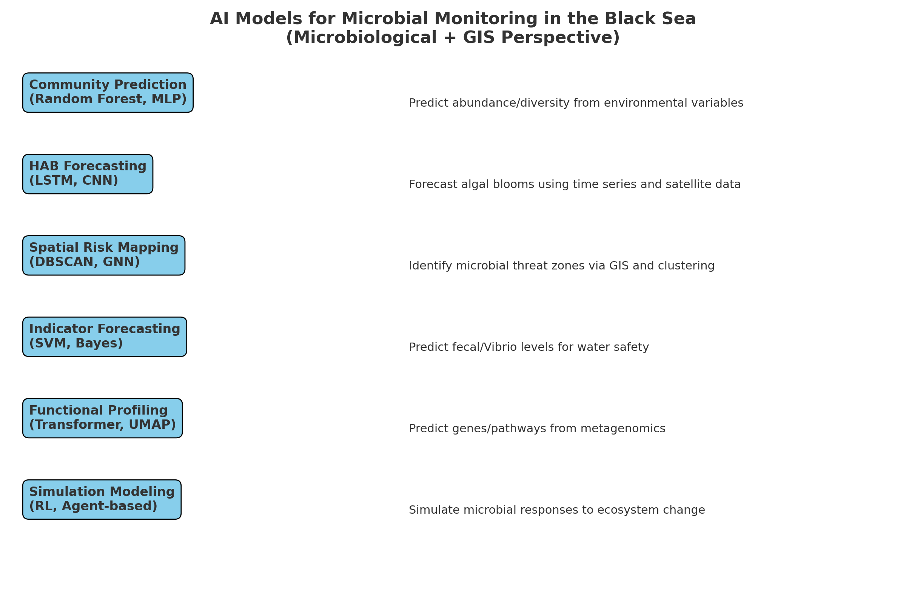

Slide 35
Benefits wfrom Integration with GIS:
All these models can output:
GeoTIFFs or raster layers showing predicted microbial patterns
Shapefiles with classification results or risk zones
Dashboards for conservation managers
(e.g., using Leaflet, Folium, or QGIS plugins)

Slide 36
References
Visialization of data: https://chatgpt.com/c/68194d50-42c8-8005-8658-9e315b71a73b
Bothelho, A., Calad0, H., Costa A. C. (2010) GIS-BASED MARINE BIODIVERSITY MAPPING FOR ASSESSMENT OF COASTAL AND MARINE PRIORITY AREAS FOR CONSERVATION January 2010 Conference: Geographic Technologies Applied to Marine Spatial Planning and Ontegrated Coastal Zone Management
Yuan Zhang, Weijun Lu, Kaihang Xing, Fen Guo, Qingping Du, Xinfei Zhang, Fan Zhang, Zongyao Qian, Feilong Li, Environmental DNA as a tool for soil health monitoring and unveiling new ecological frontiers, Ecological Indicators, Vol174,2025, 113438, ISSN 1470-160X, https://doi.org/10.1016/j.ecolind.2025.113438.
Manske, A. K., Glaeser, J., Kuypers, M. M. M., & Overmann, J. (2005). Physiology and phylogeny of green sulfur bacteria in the Black Sea. Environmental Microbiology, 7(8), 1243–1252. https://doi.org/10.1128/AEM.71.12.8049-8060.2005
Jaiani et al. (2020). Microbial Diversity and Phage–Host Interactions in the Georgian Coastal Area of the Black Sea Revealed by Whole Genome Metagenomic Sequencing. Microorganisms, Mar. Drugs 2020, 18(11), https://doi.org/10.3390/md18110558
Karadurmuş, U and Sari, M. (2022). Marine mucilage in the Sea of Marmara and its effects on the marine ecosystem: Mass deaths. Turkish Journal of Zoology 46:93-102 DOI:10.3906/zoo-2108-14

Slide 37
Yüceer, M., & Yüceer, Ç. (2022). Google Earth Engine for monitoring marine mucilage: Izmit Bay in the Sea of Marmara. Hydrology, 9(8), 135. https://doi.org/10.3390/hydrology9080135
Savun-Hekimoğlu, B., & Gazioğlu, C. (2021). Mucilage problem in the semi-enclosed seas: Recent outbreak in the Sea of Marmara. Journal of the Black Sea/Mediterranean Environment, 27(2), 140–153. https://blackmeditjournal.org/wp-content/uploads/2-2021_2_140-153.pdf
Petalas, S., Tragou, E., & Zervakis, V. (2017). Evaluation of future Black Sea river-inflow using hydrological data and Artificial Neural Networks. ResearchGate. https://www.researchgate.net/publication/321244527
Pandey, P. K., Mallik, S. K., & Yumnam, R. (Eds.). (2025). Handbook of Aquatic Microbiology. CRC Press. https://www.researchgate.net/publication/383424392
Prekrasna, I., et al. (2022). Antibiotic resistance in Black Sea microbial communities. Frontiers in Environmental Science, 10, 823172. https://doi.org/10.3389/fenvs.2022.823172

Slide 38
Moutzoris-Sidiris, I and Topouzelis, K, 2021. Assessment of Chlorophyll-a concentration from Sentinel-3 satellite images at the Mediterranean Sea using CMEMS open source in situ data. Open Geosciences 2021; 13: 85–97.
Toming, K., Kutser, T., Uiboupin, R., Arikas, A., Vahter, K., Paavel, b. Mapping Water Quality Parameters with Sentinel-3 Ocean and Land Colour Instrument imagery in the Baltic Sea, Remote Sens. 2017, 9(10), 1070; https://doi.org/10.3390/rs9101070

Slide 39
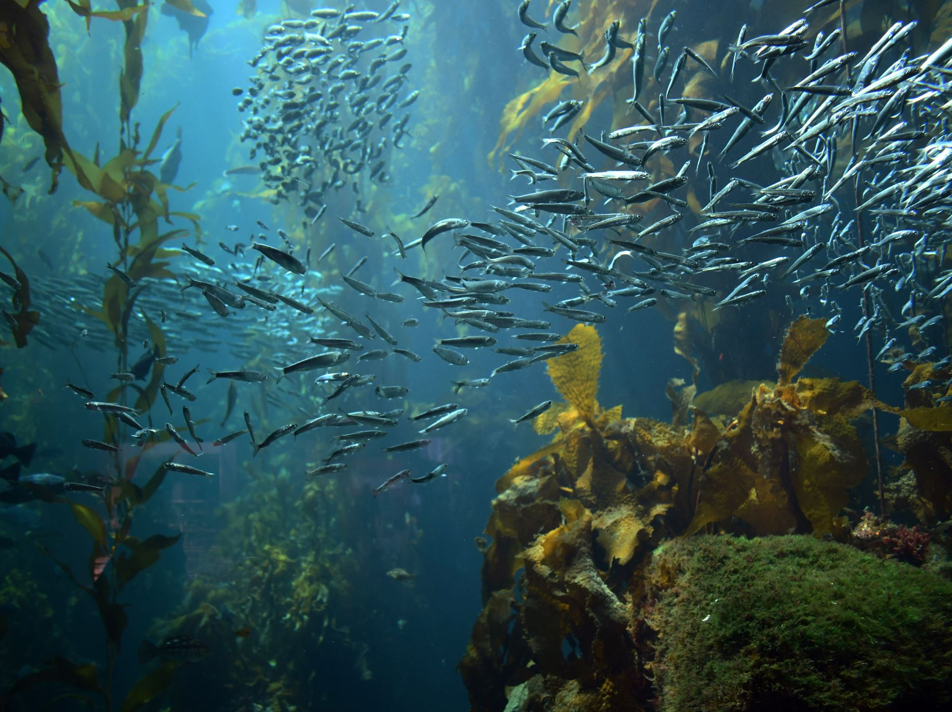

Thank You for Your Atention…

